Slide 1
Analysis on NYC Restaurant Inspection Data
Data Source: NYCOpenData Database

Slide 2
Data Info
The dataset contains every sustained or not yet adjudicated violation citation from every full or special program inspection conducted up to three years prior to the most recent inspection for restaurants and college cafeterias in an active status on the RECORD DATE (date of the data pull).
When an inspection results in more than one violation, values for associated fields are repeated for each additional violation record.
Establishments with inspection date of 1/1/1900 are new establishments that have not yet received an inspection. Restaurants that received no violations are represented by a single row and coded as having no violations using the ACTION field.

Slide 3
Method
Filter the rows where action is cycle inspection/ re-inspection
Filter the rows where cuisine description is American and Chinese
Use Folium package drawing the dispersion of the restaurants

Slide 4
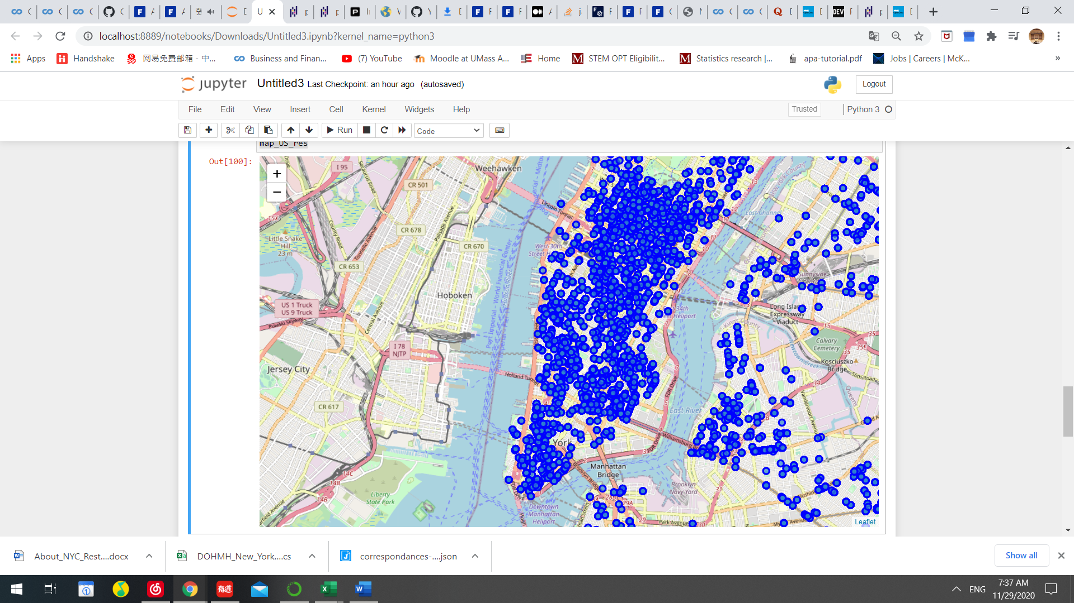
The restaurants at the Manhattan Area
The American Restaurants which received re-inspection

Slide 5
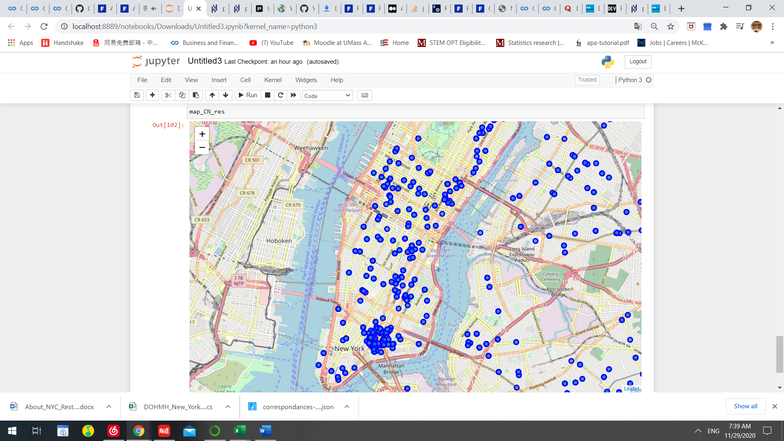
The restaurants at the Manhattan Area (Cont’d)
The Chinese Restaurants which received re-inspection

Slide 6
Explanation on the map
The analysis show that only 28% of the Chinese restaurants which received re-inspection are located at Manhattan area but 50% of the American restaurants which received re-inspection are located at Manhattan area.
The Chinese restaurants which received re-inspection are evenly dispersed across each borough. More American restaurants which received re-inspection locate at Manhattan area.

Slide 7
Discussion
This helps new owner of the restaurants making decision on the location of the new restaurants. This associates with the competition between the restaurants.
Manhattan area have more American restaurants that needs inspections.

